Slide 1
Autonomous Mobile Manipulator
Project Execution Plan and IP Landscape presentation
Tom Queen and Daniel Gregory-Turner
Abstract / intro
Notes:
2 mins

Slide 2
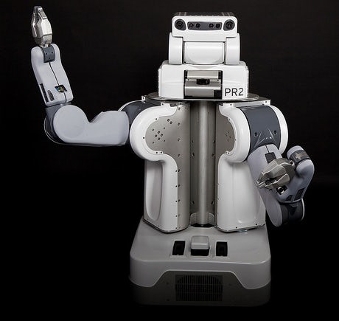
Research Question
Can a compliant robot arm be integrated into a self-navigating robot platform and programmed to autonomously to identify, locate, grasp and transport objects using data from cascaded camera systems with comparable reliability to existing systems as a function of development time and cost?
Notes:
45 seconds

Slide 3
Research Objectives
Evaluate current methods of autonomous object fetching with respect to functionality and reliability as a function of cost
Explore methods of camera based object recognition and localisation from cascaded camera systems, and the interaction between these systems
Investigate and develop a novel approach to grasping a variety of objects
Build a system capable of autonomously navigating an environment, locating a desired object and transporting the object to a location with comparable reliability to existing systems as a function of development time and cost.
Notes:
One min

Slide 4
Project description and objectives
Requirements:
Object recognition
Object localisation
Navigate to object
Positioning gripper
Object grasping
Location storage
User interface
E.g:
Verbal?
Notes:
1:30

Slide 5
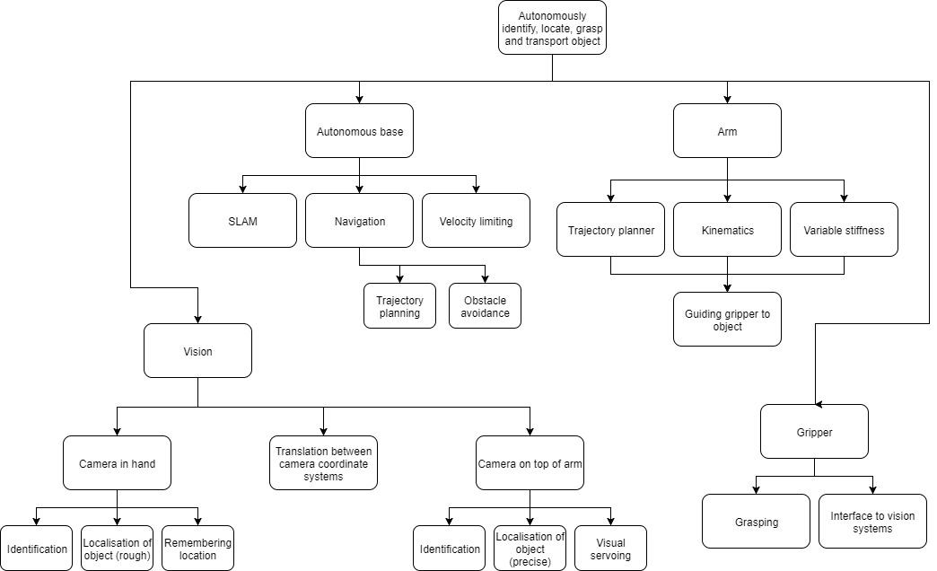
Systems Breakdown
Notes:
30 secs

Slide 6
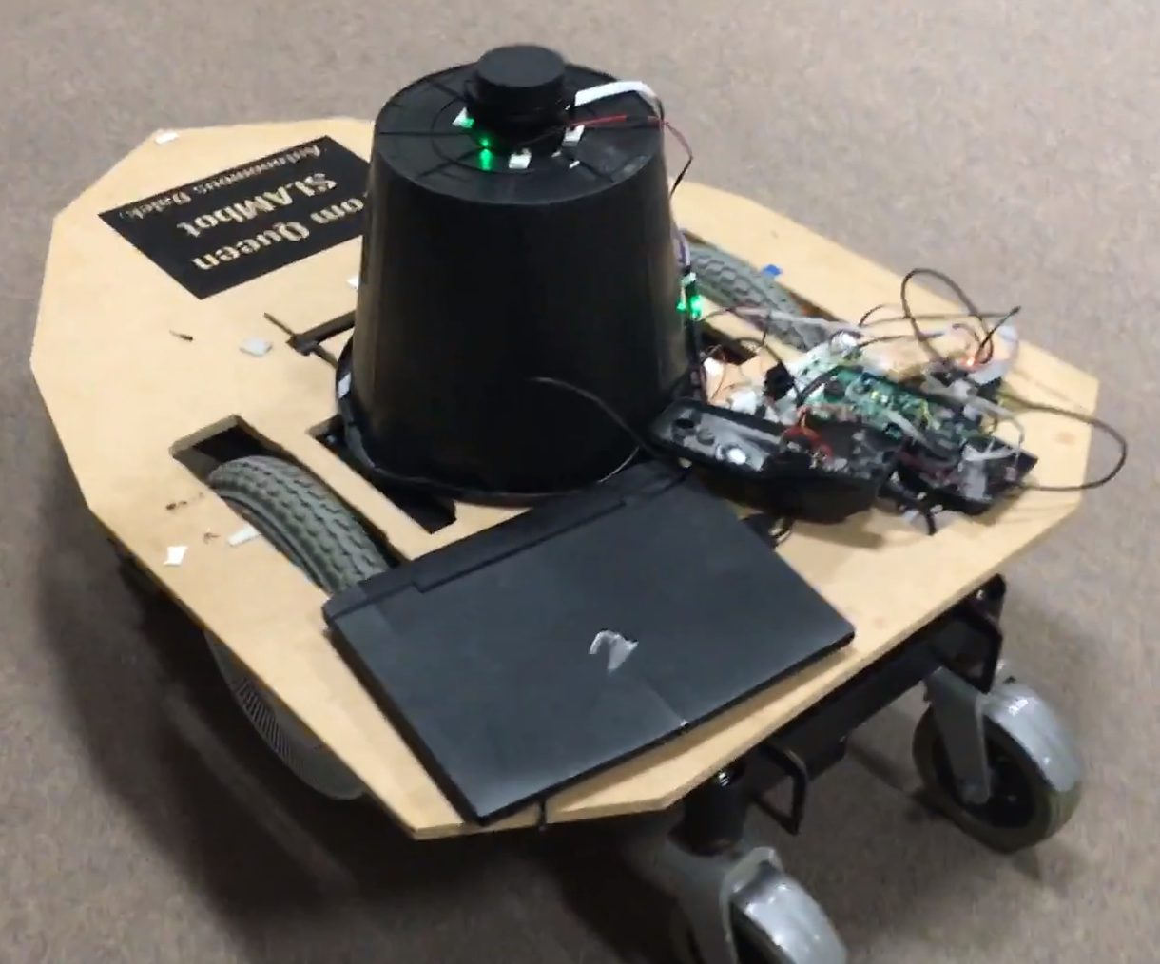
Systems overview
Hardware
Arm
Base
Gripper
Cameras
Software
ROS
Vision algorithms
Waypoint node
Control
Notes:
2:30

Slide 7
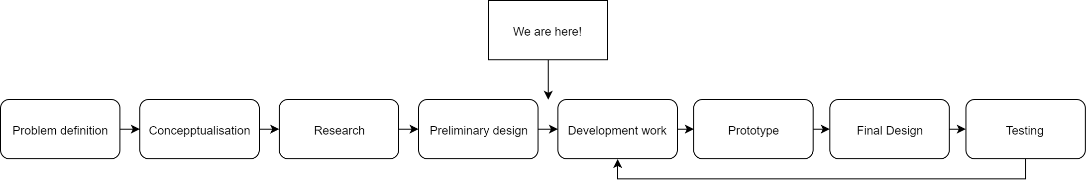
Design Process
Testing examples

Slide 8
Project Management
Example - Systems architect:
High-level design of system architecture
Identifying and specifying requirements of software subsystems
Structuring software subsystems
Specifying requirements of subsystem interfaces
Testing the interaction between subsystems
Philosophy:
Traditional project management theory
Adaptive path method
Roles and Responsibilities
 | Project manager | Electrical manager | Mechanical manager | Software manager | Systems architect | Financial manager
Tom | X | X |  |  | X
Daniel | X |  | X | X |  | X

Slide 9
Risk Management
Brainstormed potential risks to project
Gave each risk a probability and impact score
Risk priority is the product of the probability of the risk occurring and its potential impact
Description of Risk | Probability (1-10) | Impact (1-10) | Priority (1-100) | Triggers | Response Plan
Gripper self-destructs, breaking servo | 3 | 5 | 15 | Servo breaks | Replace servo with spare and order another spare

Slide 10
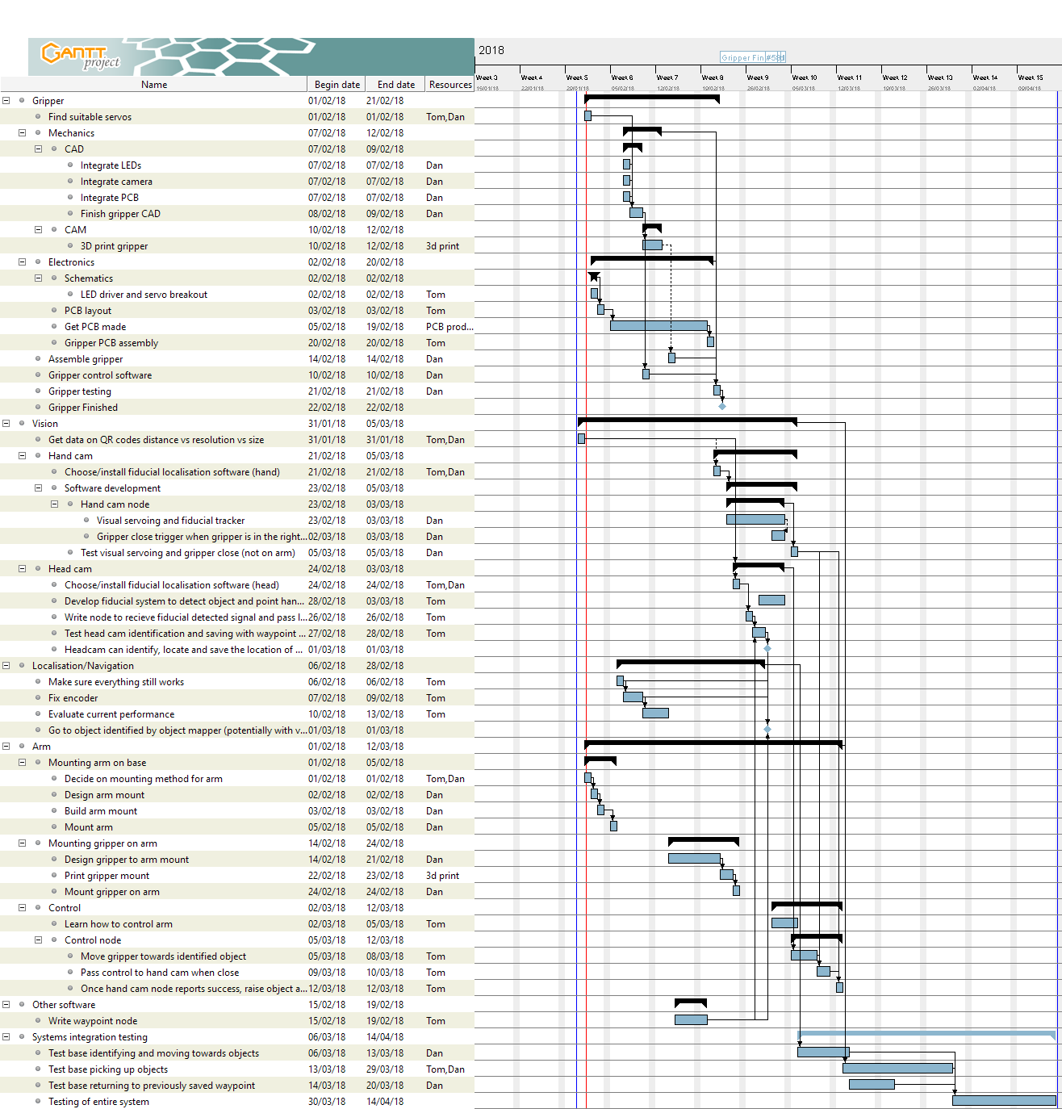
Time plan

Slide 11
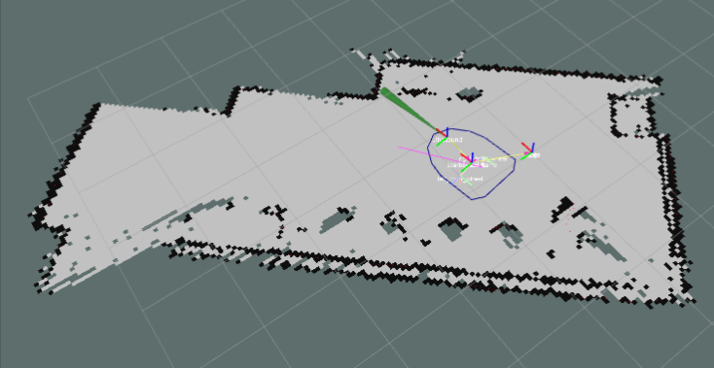
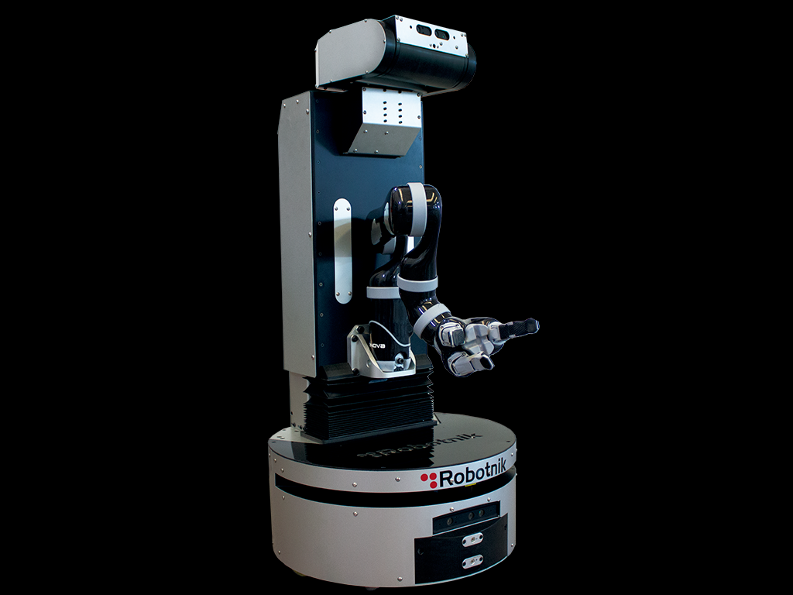
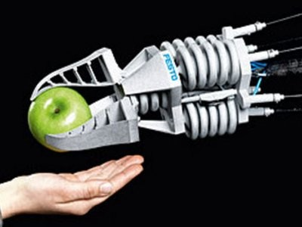
IP landscape
SLAM based platforms
Mobile autonomous manipulators
Gripping mechanisms

Slide 12
Search strategy and threat definition
Google patents
Descriptive words search results
Word combination search results
Limit search to EU, GB and US
“” to ensure exact words
Find relevant patents
Threat definition
Relation to system/sub-system
Generality of patent

Slide 13
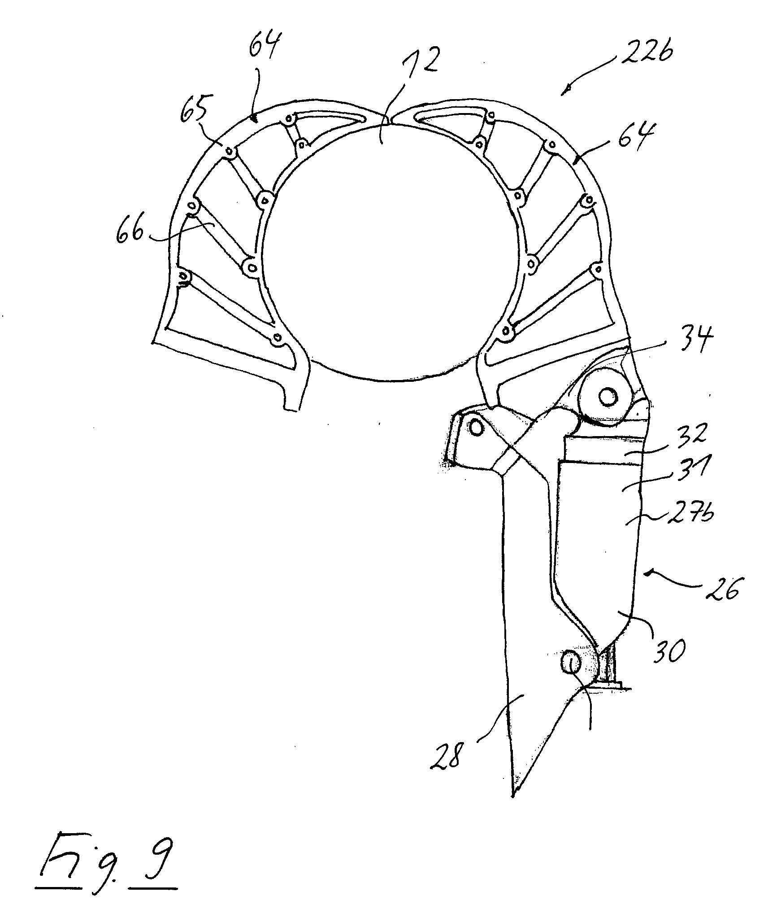
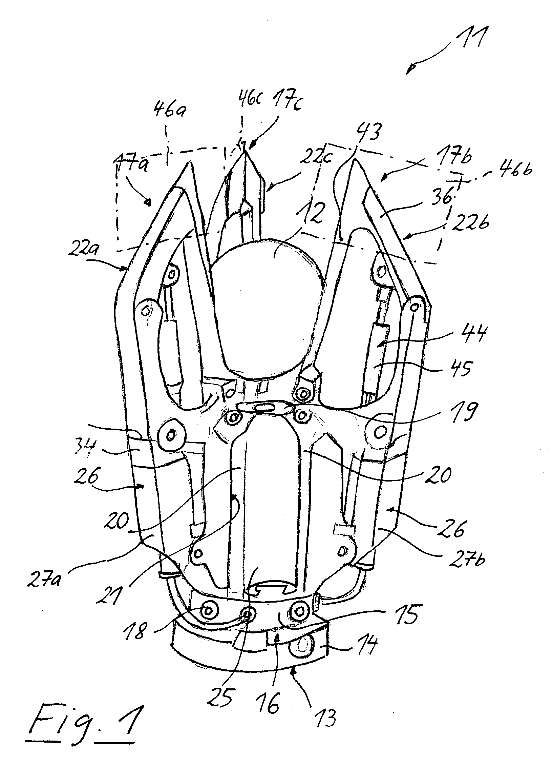
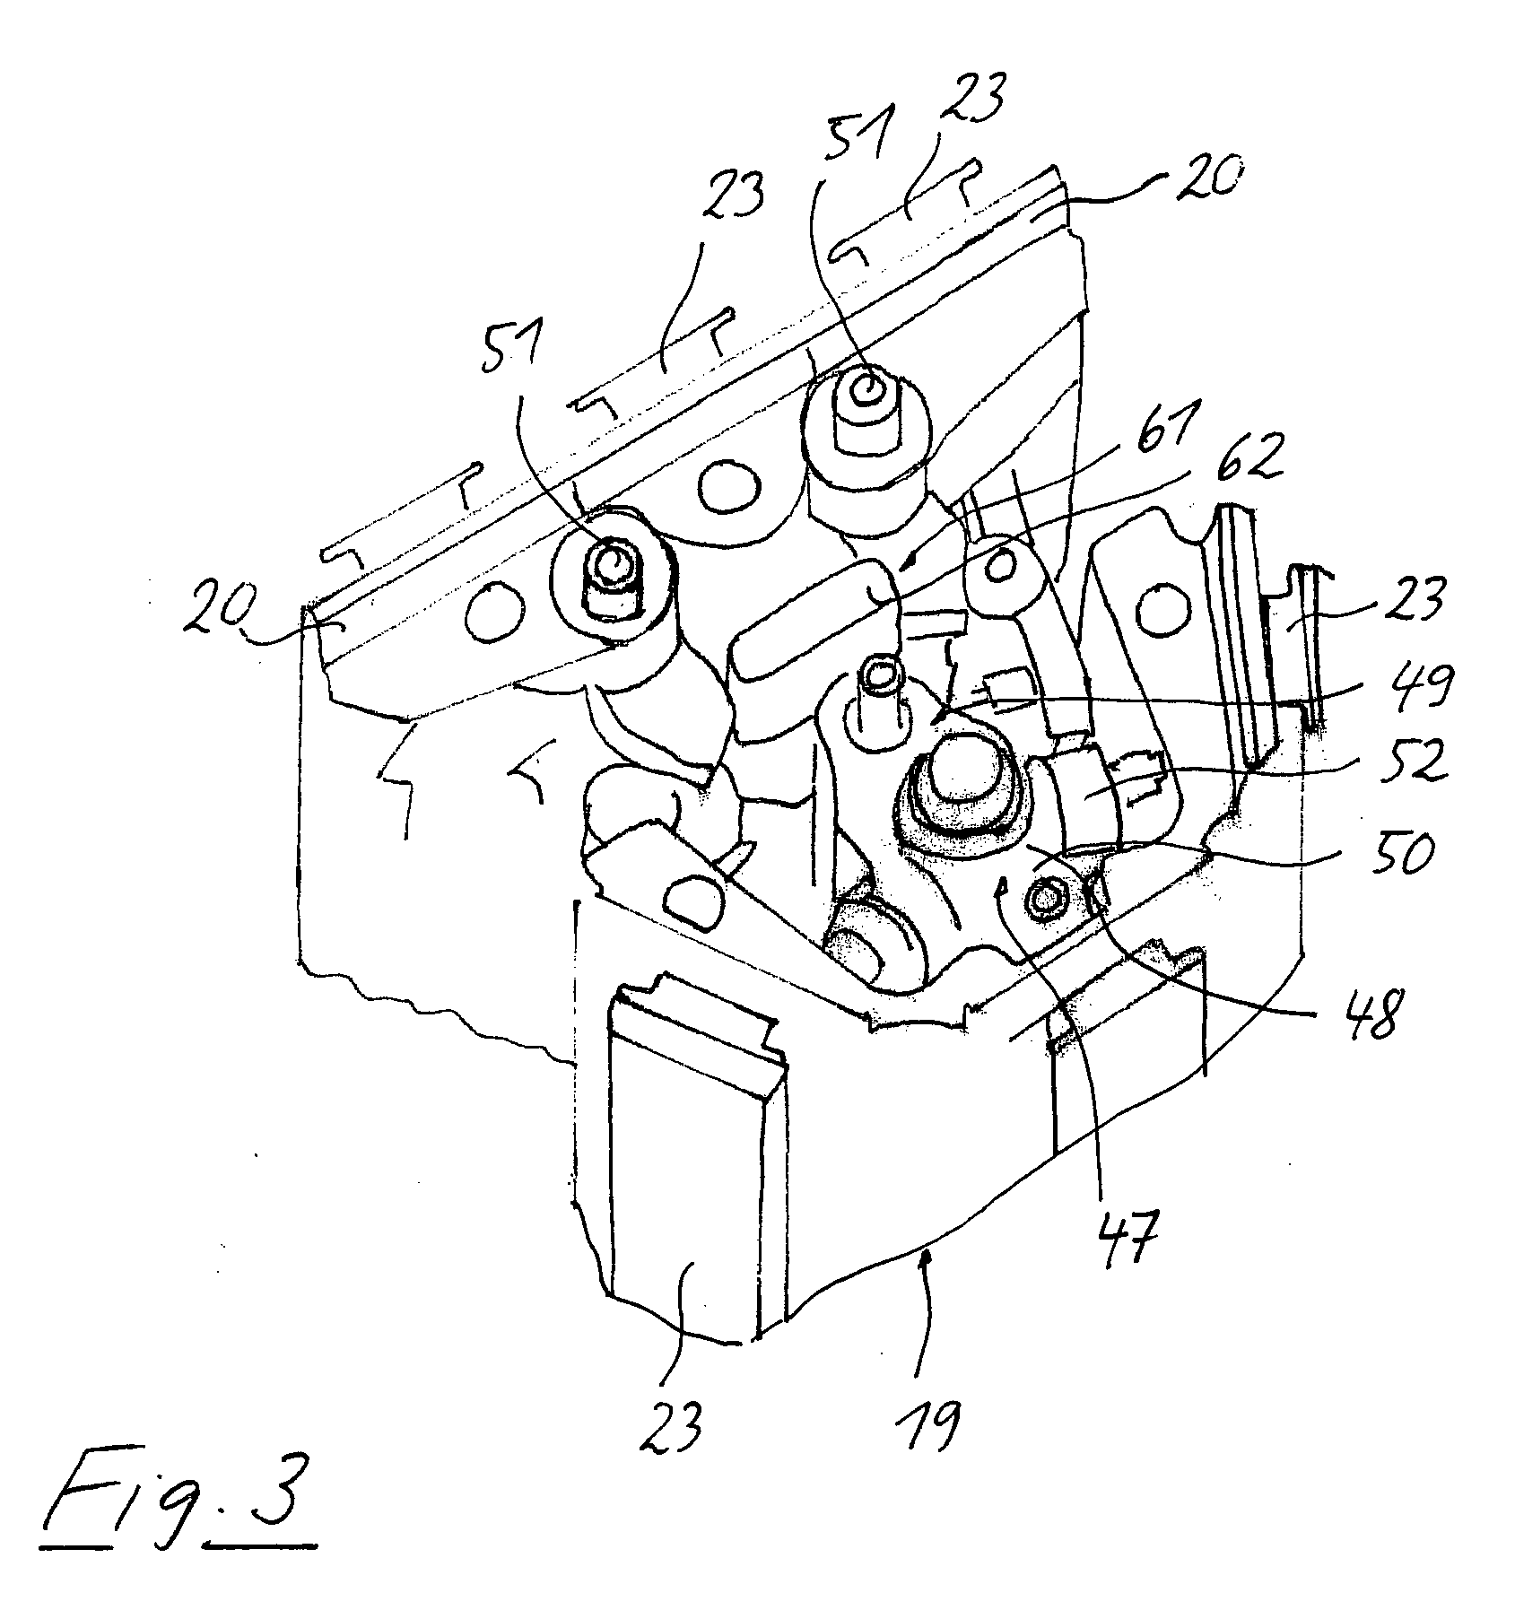
Threatening patents – Gripping device for gripping objects
Claim
Minimum of two gripping units
Movable between open and gripping position
Individual drive of each gripping unit
Releasable mounting of each gripping unit

Slide 14
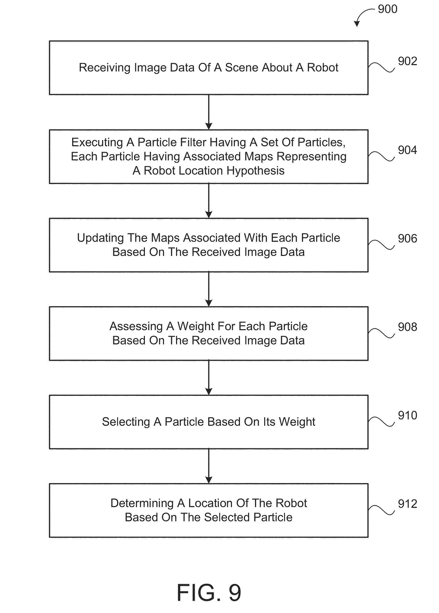
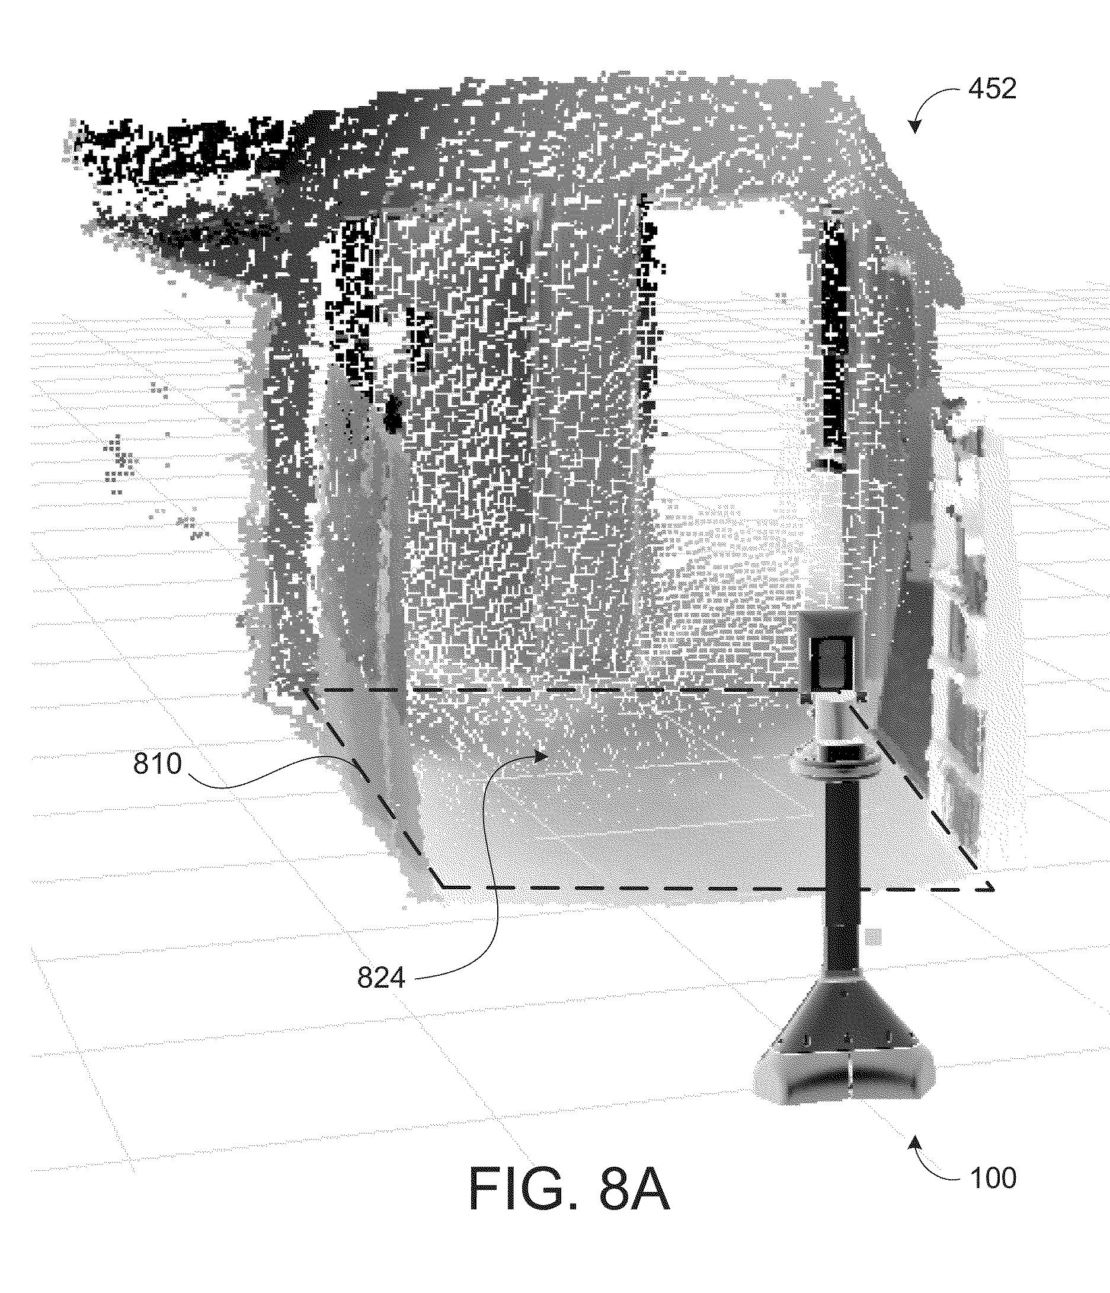
Simultaneous Localisation and Mapping for a mobile robot
Patent describes Monte Carlo localisation
Specifically mentions 3D point cloud
“receiving sensor data of a scene about the robot, the sensor data comprising a three-dimensional point cloud;”

Slide 15
Impact on project
Gripper
Some claims may impact the use of the fin-ray finger design used in the gripper
“Removable gripping element”
Should these claims be unavoidable we may need to redesign the gripper
Possible use of ground coffee gripper design
Rigid designs may need to be explored
SLAM platform
“3D point cloud”
Does not affect use of 2D lidar however may limit use of visual slam

Slide 16
Thank you
Any Questions?

